Slide 1
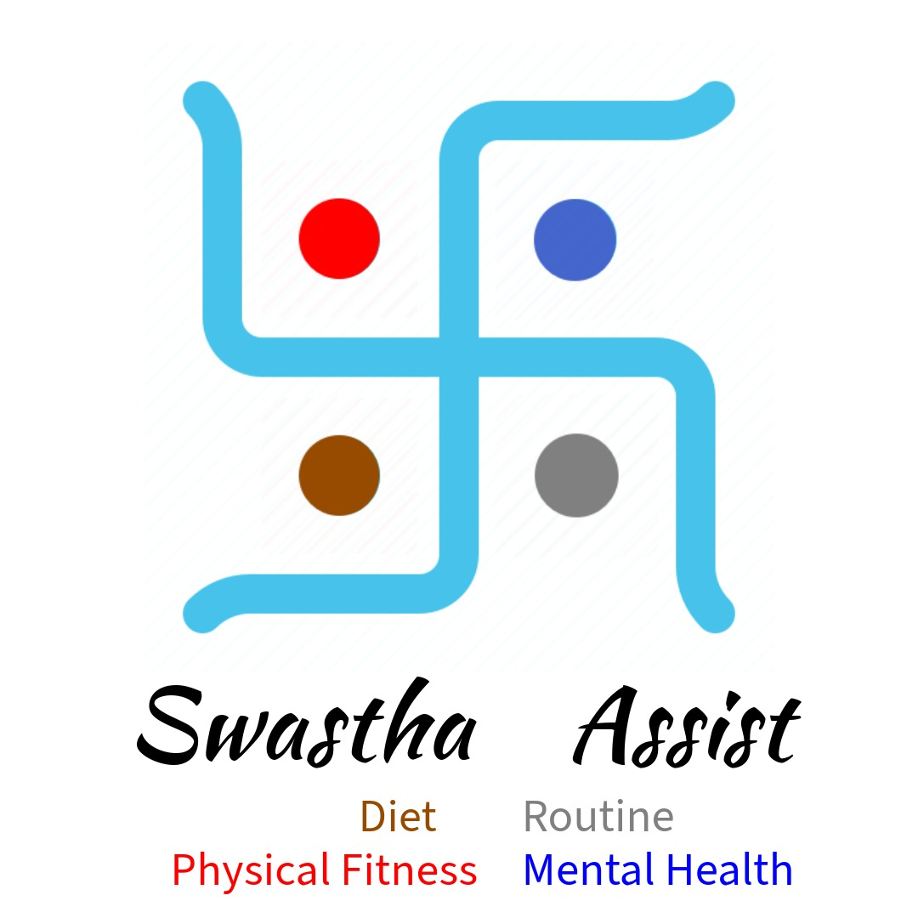

Slide 2

INTRODUCTION
Our idea is meant for addressing health and nutrition challenges in India. We are developing an website named Health Assist. It's main objective is to provide health assistance to teenagers, adults and senior citizens. Our website is mainly divided into four sections which are the principles of living a healthy life.

Slide 3
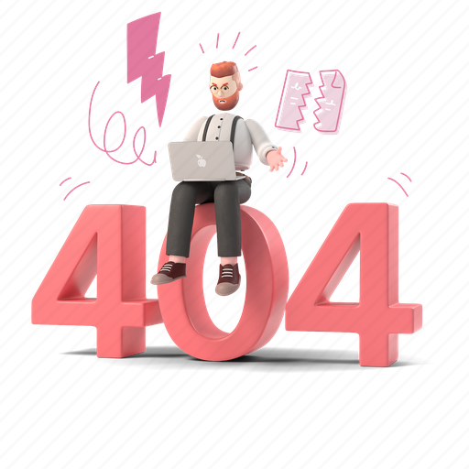
SELECTION OF PROBLEM STATEMENT
We were analysing the problem statements and we thought that there is much need of innovation in health sector. We selected the problem statement “Innovate to build solutions to find novel ways to address health and nutrition challenges such as malnutrition, obesity etc.”
We started to think that how can we tackle health and nutrition problems. We thought that having a healthy lifestyle can address health issues such as malnutrition, obesity, diabetes etc.
We thought that for this we can work on an application which aims to provide healthy lifestyle through health assistance.
It has to be different from the existing one so we thought of providing personalized health assistance to teenagers, adults and senior citizens.

Slide 4

DESCRIPTION OF IDEA
We have divided the website mainly in four sections
Routine
Diet
Physical fitness
Mental health
Apart from these areas our website also includes health record, health journal and advice corner. Here I will explain about these all features with some illustrations of our app screens.
This is just explaining that how different features will work but for creating final product we will need a large database and help from health experts.

Slide 5
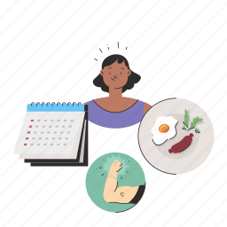

ROUTINE
Our website gives recommendation to users to manage their daily routine it gives them recommended activities that they should include in their routine as per their profession and age group. It also analysis the time they spent on a particular activity which help them to summarize their whole day.
The innovative element is that it also focusses on the personality development of the user. It has features for effective time management , increasing productivity, routine analyzer etc.

Slide 6
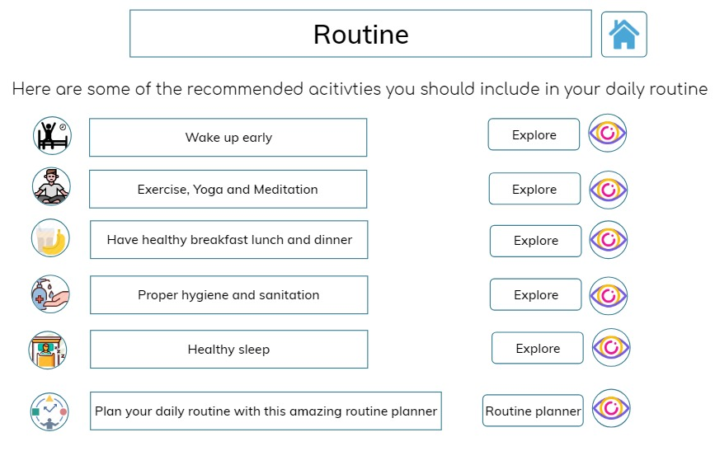
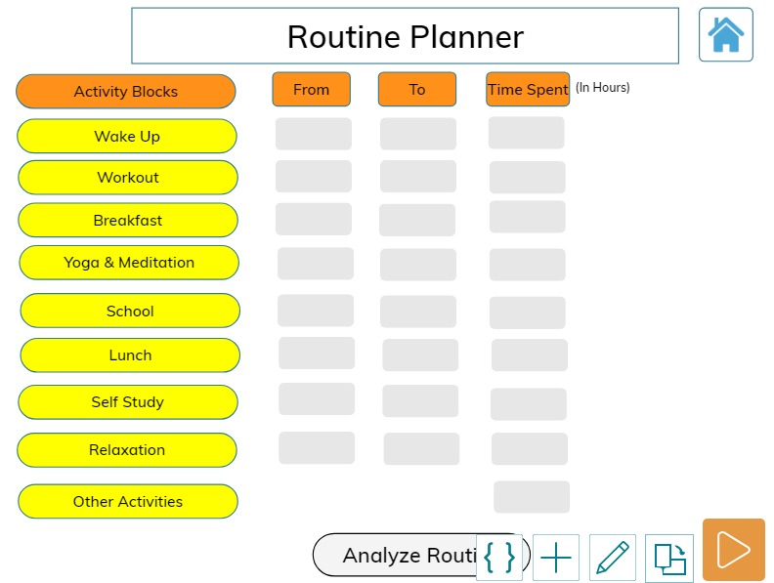

Slide 7
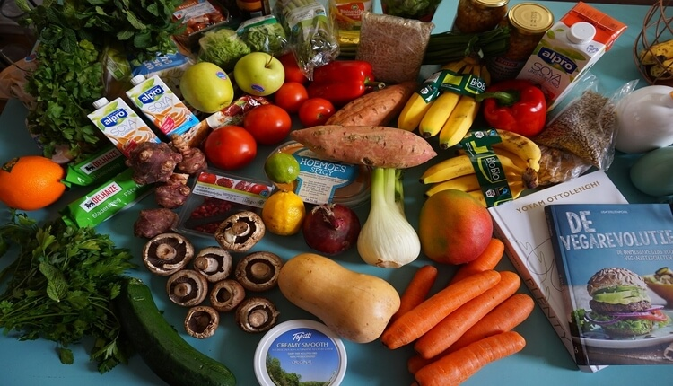
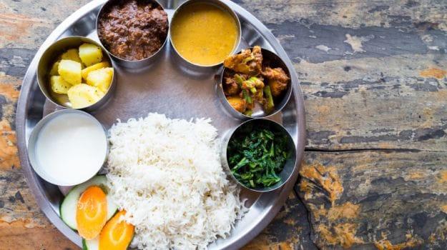
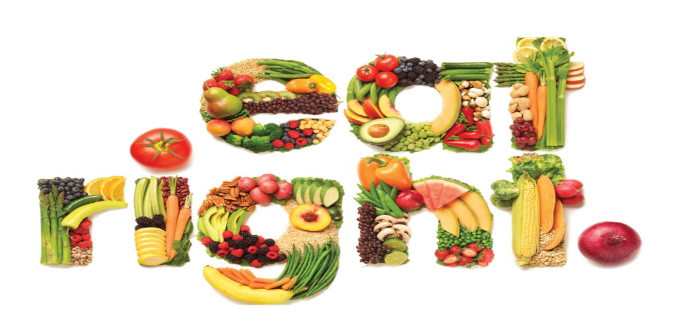
DIET
This section involves the recommendation of diet as per persons BMI, Age group, Gender and disease. It also includes a meal planner and a food database.
The innovative element we proposed is elements of healthy kitchen.
We are also planning to add the concept of Satvik , Rajsik and Tamsik food.

Slide 8
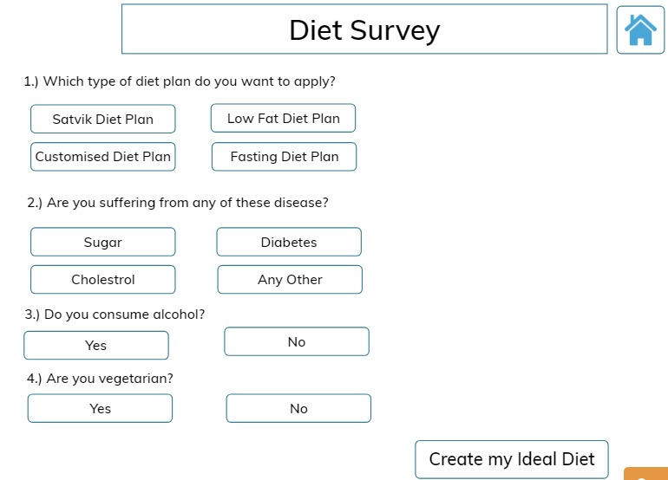
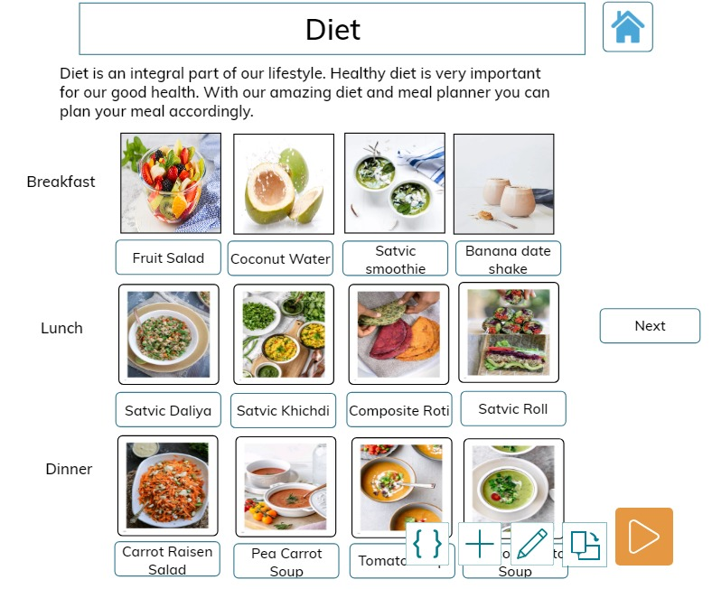

Slide 9

PHYSICAL FITNESS
This section helps users to find particular set of workouts, yogic Aasan and practices as per their requirements.
We have divided yogic practices and workouts in three different levels of beginner, intermediate and advance.
You will get course wise lesson plan for exercises and workouts.

Slide 10
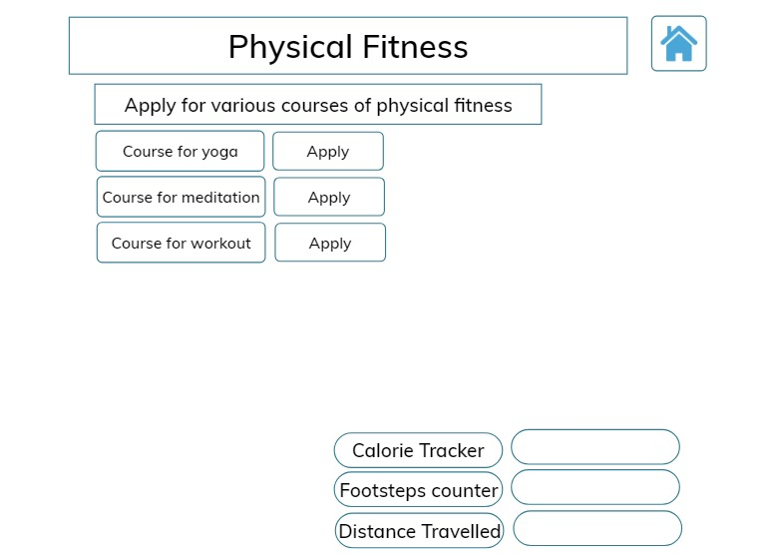
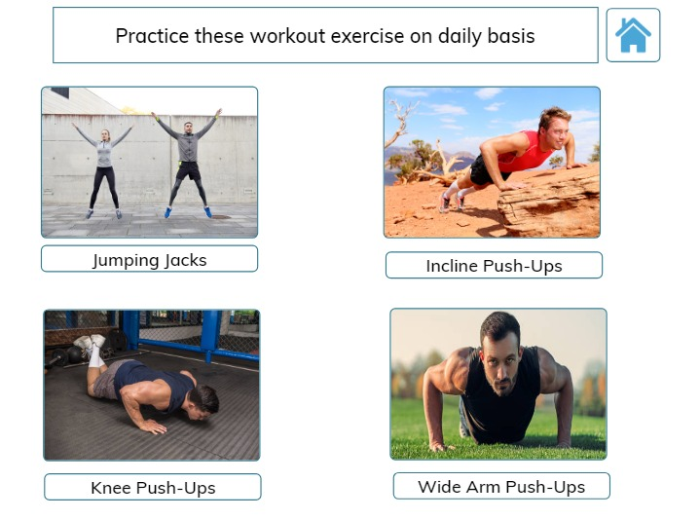

Slide 11

MENTAL HEALTH
This section focusses on mental health and addresses problems like stress anxiety depression.
Analysis of mental health through various set of questions.

Slide 12

INNOVATIVE FEATURES
Personality development section.
Elements of healthy kitchen.
Satvik, Rajsik, Tamsik concept.
Personalize routine planner as per profession.
Lesson wise plan for yogic practices and workouts.
Health worksheets/assesments.
Know yourself(intrapersonal analysis).

Slide 13
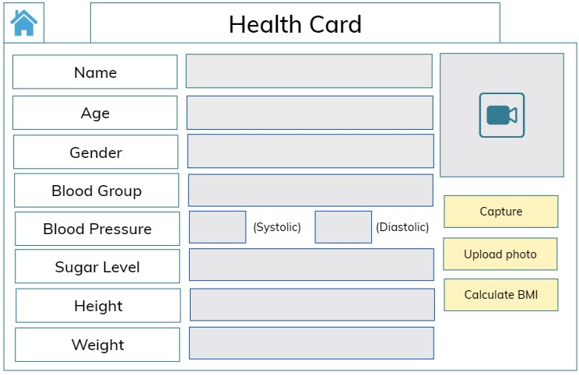
HEALTH CARD

Slide 14
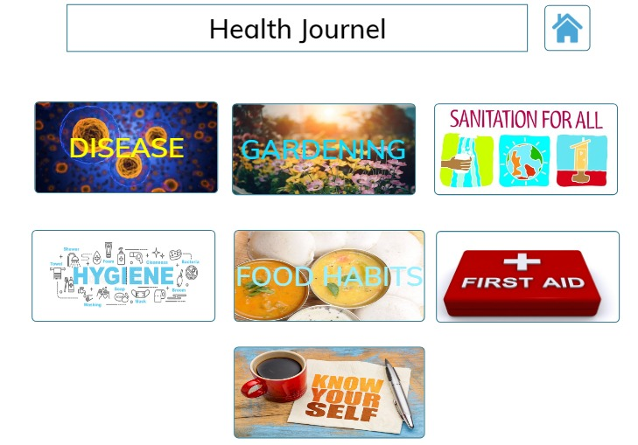
Health journal is like a blog spot. It addresses the problem of lack of health and nutritional information it has various articles regarding different health issues and ongoing health problems.
HEALTH JOURNAL

Slide 15
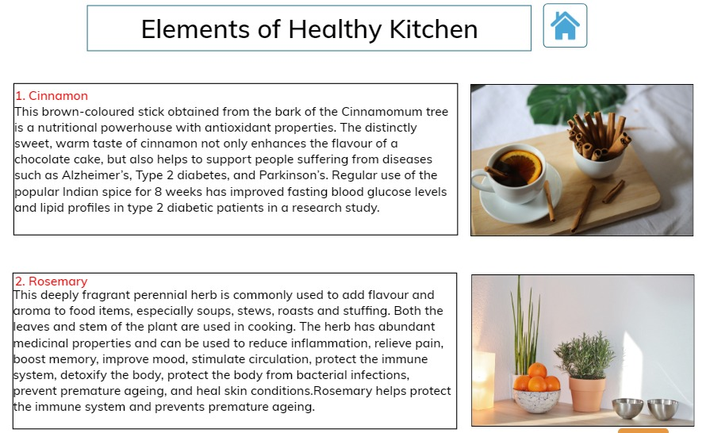
ELEMENTS OF HEALTHY KITCHEN

Slide 16
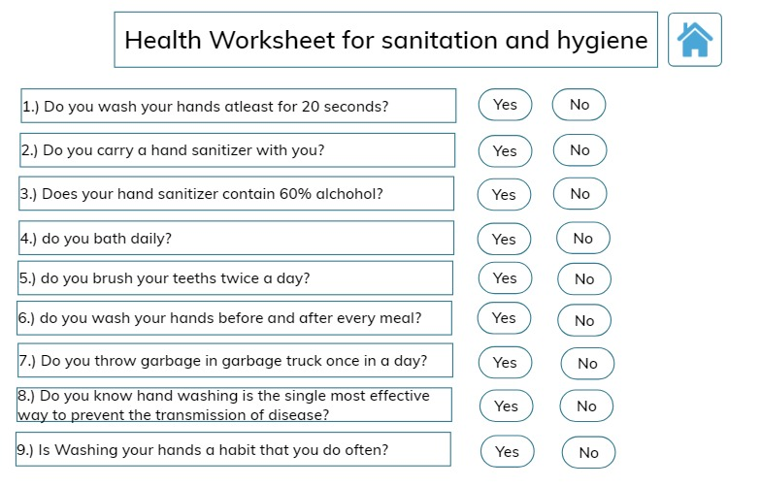
HEALTH WORKSHEET

Slide 17
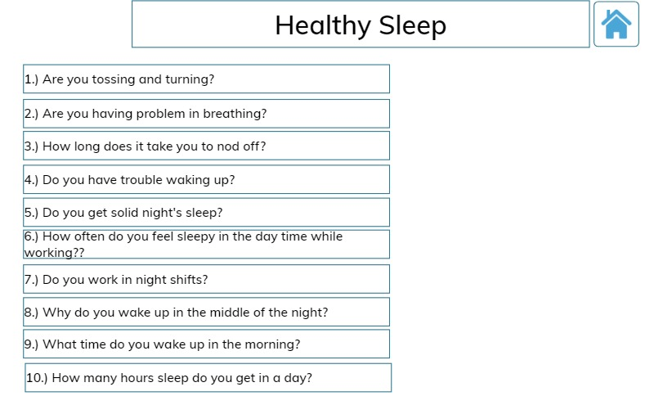
HEALTHY SLEEP

Slide 18
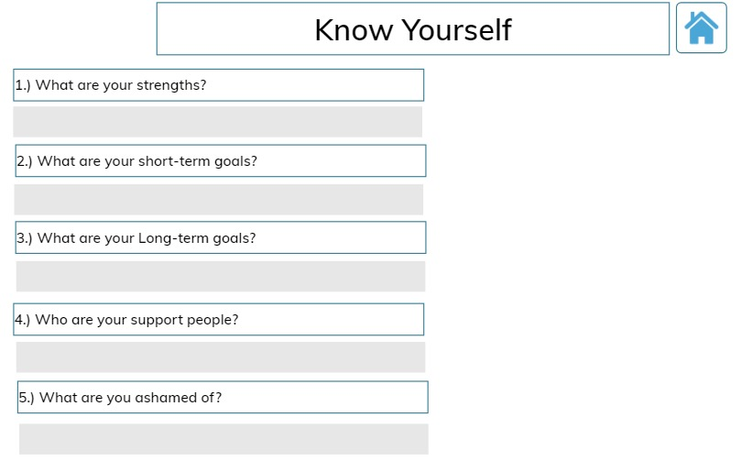
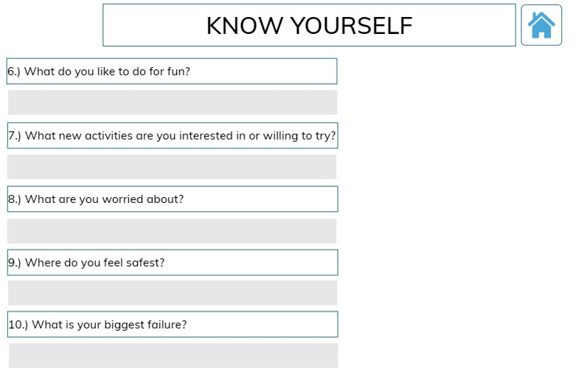
KNOW YOURSELF

Slide 19
DIET SURVEY

Slide 20
RESEARCH ON THE IDEA
ON GROUND TESTING AND IMPLEMENTATION:
We interacted with some people around us and recorded their statements.
PERSON 1 (Senior citizen): This app is really very useful for senior citizens for keeping track of their reports, having information about health issues but there is need to add something to make it them enjoy the app.
PERSON 2 (Adult): This app is beneficial for people having disturbed routine due to odd working hours. Idea of elements of healthy kitchen is very amazing for transforming our kitchens.
PERSON 3 (Adult): App idea is good but it needs to be refined to be more interactive. Know yourself is good for analyzing yourself.
PERSON 4 (Adolescence): App is useful for teenagers for managing their routine, time management, increasing productivity getting information about reproductive health, menstrual cycle etc.
We have done surveys in our locality and also interacted with our classmates. These are some glimpses of our interaction.

Slide 21
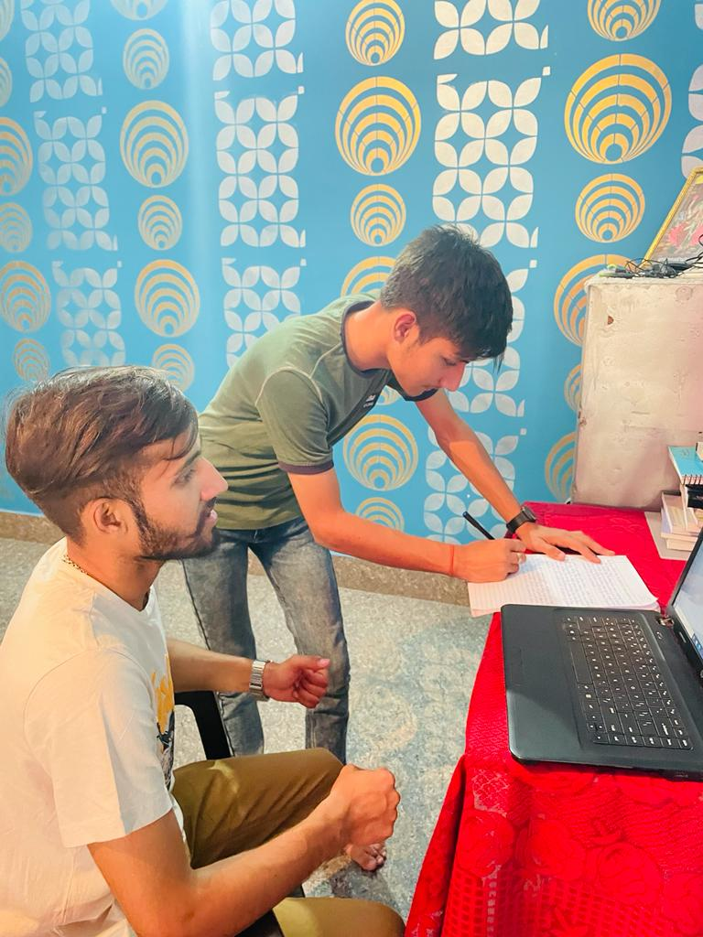
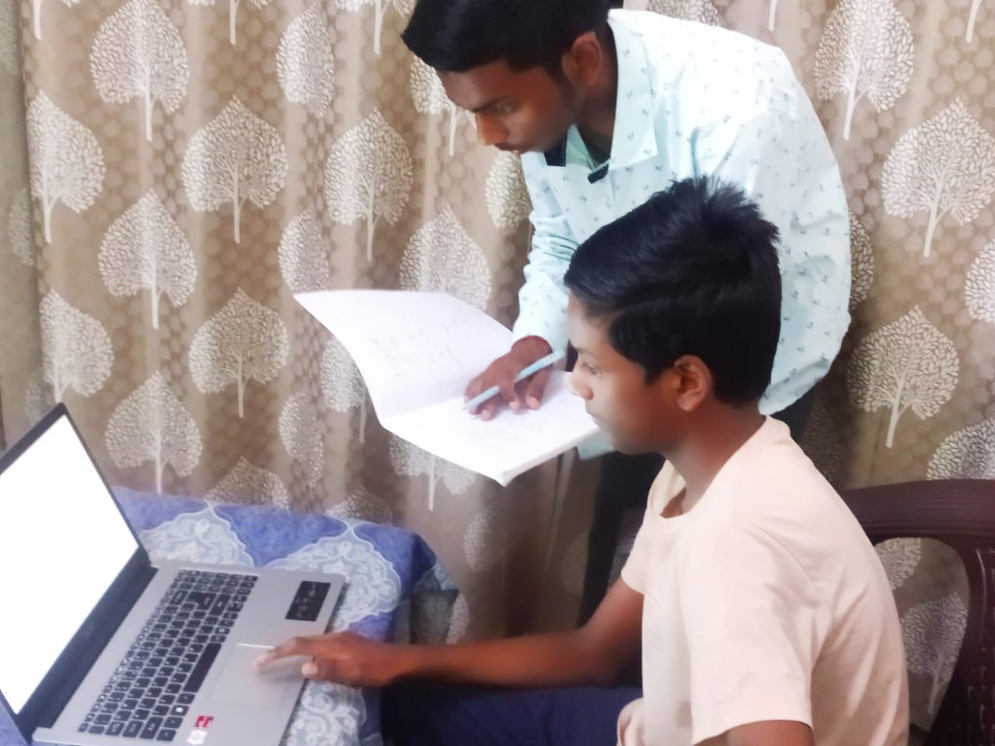
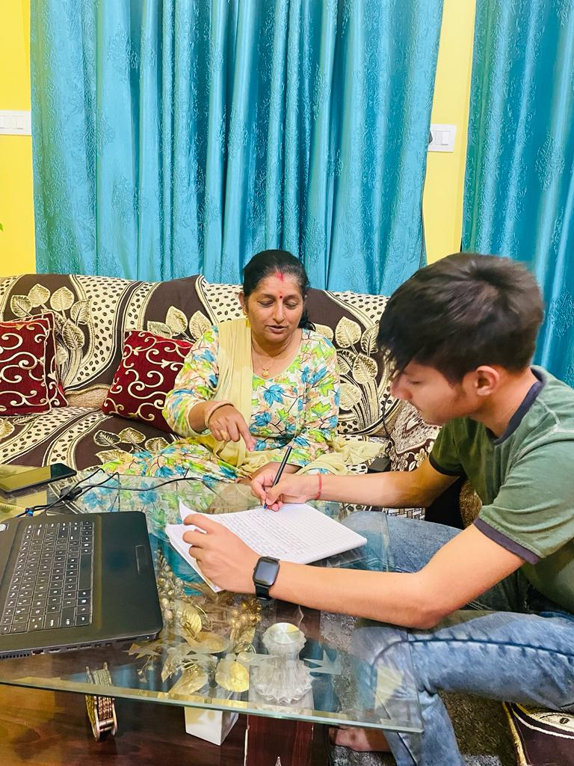
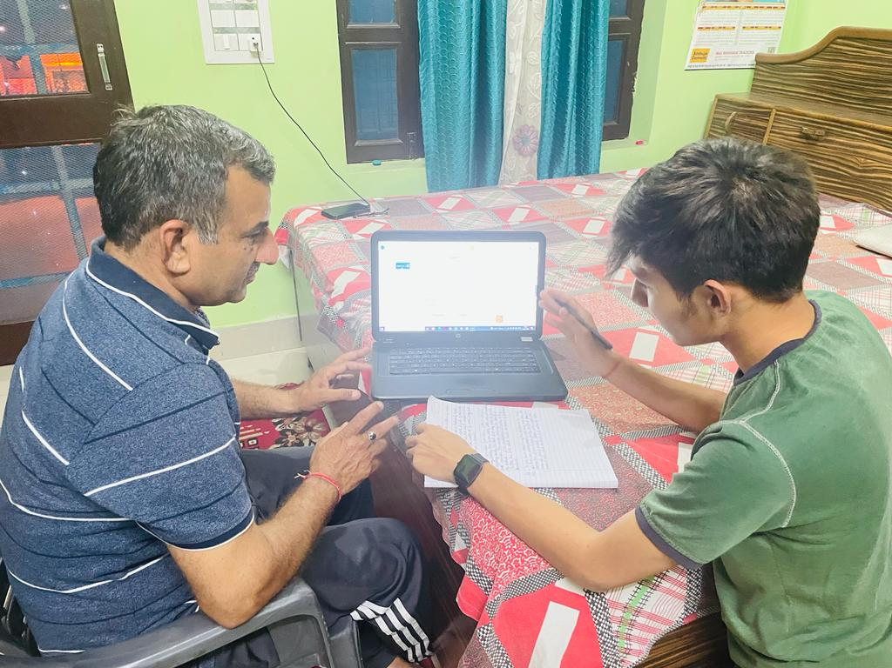

Slide 22
COMPARISON BETWEEN FEATURES OF OUR APP AND EXISTING APPS
FEATURES | EXISTING APPS | OUR APP | INNOVATION
ROUTINE PLANNER | YES | YES | Personalised as per profession and age
CALORIE COUNTER | YES | NO
ELEMENTS OF HEALTHY KITCHEN | NO | YES | Integrating ayurvedic knowledge in modern health apps
COURSE ON YOGA AND EXERCISE | YES | YES
HEALTH WORKSHEETS AND ASSESMENTS | NO | YES | Self-analysation on practice of healthy habits + collection of data for recommendation in different way
HEALTH JOURNAL & HEALTH CARD | NO | YES | Prescription sheet
MEAL PLANNER | YES | YES
PERSONALITY DEVELOPMENT | YES | YES
PERSONALIZED CARE FOR ADOLESCENCE, ADULTS & SENIOR CITIZENS | YES (but not in single app) | YES | Combined in one single application
KNOW YOURSELF | NO | YES | Intrapersonal analysis

